Slide 1


SAP UI5 & FIORI with OData TRAINING
Anubhav Oberoy & Shekhar Vedi
Day – 3

Slide 2

Agenda – Day 3
Working variables in JavaScript
Some Important point related to JavaScript
Methods to apply JS in HTML
Functions in JS
Synchronous and Asynchronous behavior in JS
Data Types in JS
Arrays and Object in JS
Introduction to jQuery
- - Break
Introduction to CDN (content delivery network)
Introduction to NodeJS
Creating a server using NodeJS
Using external libraries in the Project
Under the hood of SAP UI5
Introduction to the MVC Architecture
Introduction to the SAP UI5 SDK
Creating our First UI5 Application
Introduction to views in UI5

Slide 3
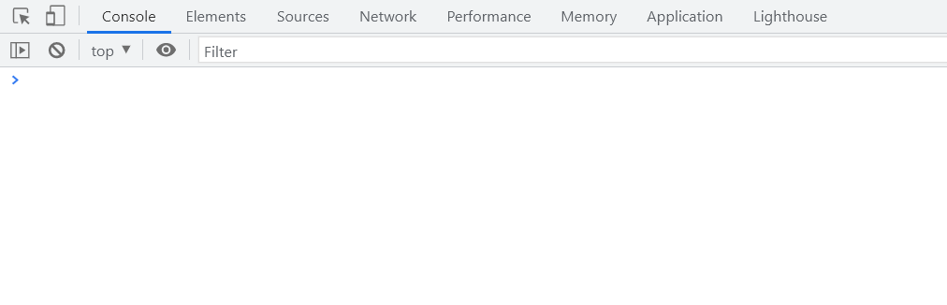
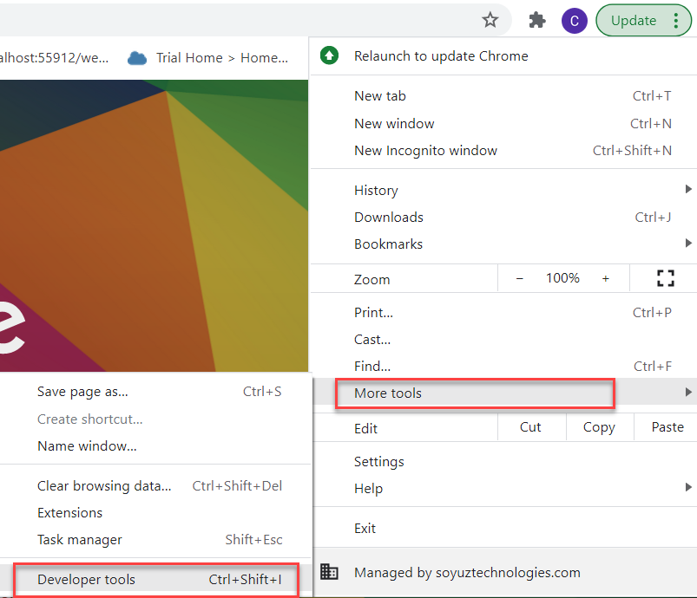
Creating the Variables in JS
In a programming language, variables are used to store data values.
JavaScript uses the keywords var, let and const to declare variables.
An equal sign is used to assign values to variables.
JavaScript variables are case sensitive.
Example: -
var x; var a = 10; let y; var b = ‘Hello World’;
How to access Console in the Browser.
We can access the console in the browser by pressing F12 on the keyboard.
On console we can execute the JavaScript commands, and we can also view the output over there.
We can also access the console form developer tools.

Slide 4

Exercise
Now we will see how to create variables in JS and what are the type of variables.
We will also perform some basic operations on the variables.
Exercise Code/Resources:-
- JSBasics

Slide 5
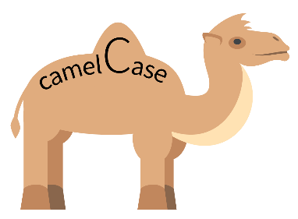
Some Important Point related to JavaScript
JS is case-sensitive (80% developers does case-sensitive errors)
Every statement in JS ends with semi-column
In JS = is an assignment operator, == and === are comparison operator, == compare only value and === compare data type also
We can declare variable in JS w/o any data type, based on the value assigned to the variable system auto determine the variable type, the keyword to declare variable is var.
JS Naming convention is camel case, the first letter of any word is small, next consecutive word’s first letter is caps.
Ex:-
iloveindia ➔ iLoveIndia
wearelearningJS ➔ weAreLearningJs
Methods to Apply JS in HTML
Inline JS – The script code is applied at html element level using events e.g., onclick, ondblclick, onhover, onkeypress. This is not recommended as its not reusable.
Internal JS – We write script code inside a script tag. We can use functions for that. There are 2 types of function. Which means it is reusable.
External JS – JS code is written in another file which has extension as .js. We will link it with our script tag. In the same way we linked CSS with link tag.

Slide 6
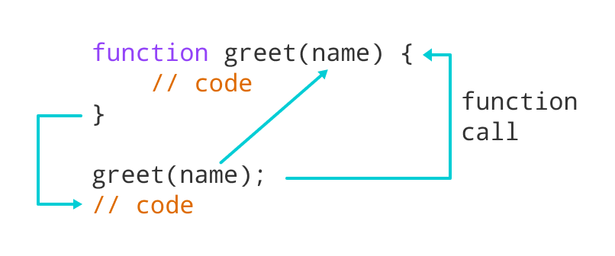
Function in JavaScript
Functions in JavaScript
A JavaScript function is a block of code designed to perform a particular task.
A JavaScript function is executed when "something" invokes it (calls it).
A JavaScript function is defined with the function keyword, followed by a name, followed by parentheses ().
The code to be executed, by the function, is placed inside curly brackets: {}
Function parameters are listed inside the parentheses () in the function definition.
Function arguments are the values received by the function when it is invoked.
Inside the function, the arguments (the parameters) behave as local variables.
Types of functions
Functions are of 2 types →
1. Anonymous function 2. Named Function
function(params) {
//code
}
function functionName(params) {
//code
}
JS also has 2 very powerful built-in/system variables which we can use out-of-box.
document = it is the object of DOM and can be used to access all the HTML elements on the page. The document object has so many reusable functions like getElementById, getElementsByClassName, getElementsByTagName
window = it is the object of our browser window

Slide 7
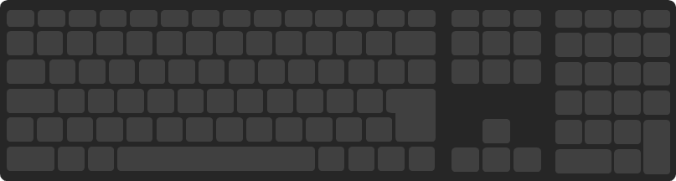
Exercise
Now we will see some example related to Inline, Internal and External JS
Design a login screen with login button. If user enter user and password SAME login user by changing DOM to login success. Else show an alert that username and password invalid.
Exercise Code/Resource:
JSBasic
mycode.js

Slide 8
Synchronous and Asynchronous Response
User
Screen
Server
Database
Save
Processing
Time
Request send to server
Request to Database
Synchronous Response
For all this time user
Remains blocked
Response form Database
Save
Request send to server
For all this time user
Remains blocked
Request to Database
Asynchronous Response
For all this time user
Is Not Blocked
Response from the server
Response form Database

Slide 9
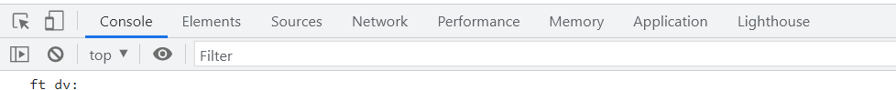
JavaScript Debugging Tools
Debugging is the process of detecting and removing of existing and potential errors (also called as 'bugs') in a software code that can cause it to behave unexpectedly or crash.
In order to debug JS code effectively, start the web app in a new tab/window, open F12 with option Sources tab. Set up the Break point by clicking on the line number.
Shortcuts for debugging are as below
Type | ABAP | JS
Step-in | F5 | F11
Step-out | F7 | Shift+F11
Go to next | F6 | F10
Continue (till Next BP) | F8 | F8
There are several tabs in the console, while working on the application we are mainly focused on Console, Elements, Source and Network Tab.
Console: It is the place where we run the JavaScript Code and Print the output for testing and Debugging
Elements: It shows the DOM of the current page open in browser.
Source: All the JavaScript code of the app or page will be visible here. We can also debug the code form here.
Network: We can see all the Network related calls made by the application in this section.

Slide 10
Data Types of JavaScript
Data types in JavaScript describe the different types or kinds of data that you will be working with and storing in variables. It's important that you learn each of these data types because otherwise data can get stored in an improper format which will result in issues in your code later.
JavaScript Data Types
Primitive
Non-Primitive/Reference
String
Array
Object
Number
Boolean
Undefined
Null
Symbol

Slide 11
Arrays and Objects in JS
Array: An Array is a collection of data and a data structure that is stored in a sequence of memory locations. One can access the elements of an array by calling the index number such as 0, 1, 2, 3, …, etc. The array can store data types like Integer, Float, String, and Boolean all the primitive data types can be stored in an array.
Object: An Object is a non-primitive, structured data type in JavaScript. Objects are same as variables in JavaScript, the only difference is that an object holds multiple values in terms of properties and methods.
Syntax for object
var oObjName = { “prop”: value,
“prop”: value,
“prop”: value }
Syntax for Array
var aItems = [item0, item1,….]
Ex:
var myArr = [1, 2, 3, 4, 5];
var myArr2 = [‘a’, ‘b’, ‘c’];
Example of an Object
{
//this is an EntitySet of type object (single)
"empStructure": {
"empNo": 100,
"empName": "Latika Roongta",
"salary": 9000,
"currency": "EUR"
}
}
Java Script Object Notation – JSON
You can validate json using https://jsonlint.com
Elements or properties
Entity set

Slide 12
Exercise
In this exercise we will create a JSON, and then will print the data in that json on the console on press of a button on the HTML page.
Exercise Code/Resource:
JSBasic
mycode.js

Slide 13

Introduction to jQuery
jQuery is a java script library, which is used to simplify our JS code.
It’s free to use
Used by top software companies like google, Netflix, etc.
Light weight JS library
jQuery greatly simplifies JavaScript programming.
Available on internet
Purpose is to write less and do more
Industry standard
How to use?
Download the jQuery library and keep it in our project, just like we use util/mycode.js
Reference jQuery from CDN (Content Distribution/Delivery Network) – directly reference it from internet
Syntax:-
$(selector).action();
Selector:-
tagName, .className, #id
$ - indicates browser that we willing to use jQuery
Selector – tell browser to target which are all the element(s)
Action – events, functions, special functions
Documentation of jQuery is available @ https://jquery.com

Slide 14

Exercise
In this exercise we will use jQuery to add some animations in our HTML page.
Exercise code/resource:
JSBasic
mycode.js

Slide 15

Break

Slide 16
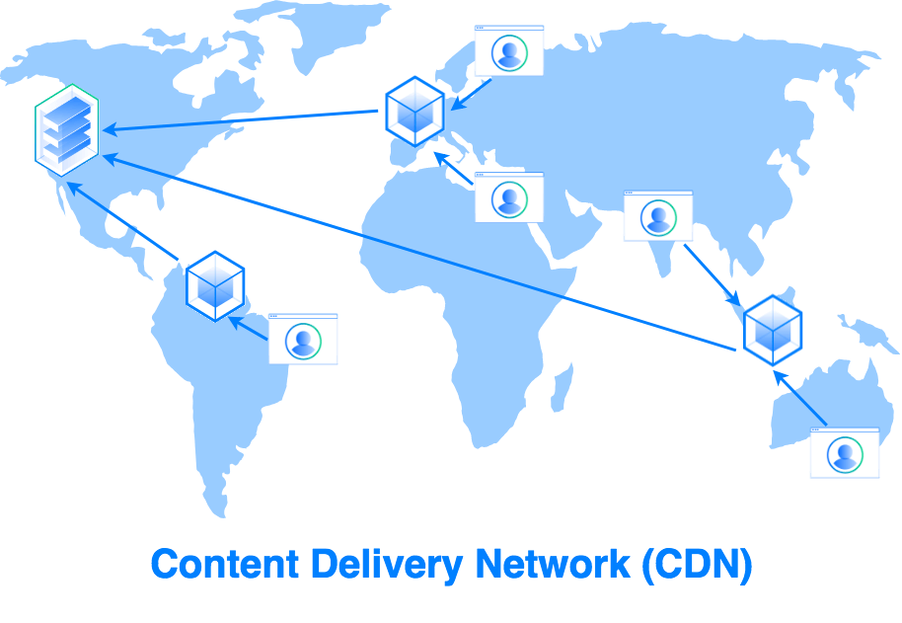
Content Delivery Network
A content delivery network (CDN) is a group of geographically distributed servers that speed up the delivery of web content by bringing it closer to where users are.
CDNs are a layer in the internet ecosystem.
Different loading time for users at different locations.
USA
Miami
Detroit
Mycode.js
Server
Mumbai
Mycode.js
India
Bangalore
Mumbai
Japan
Tokyo
Hongkong

Slide 17

Introduction to NodeJS
Node JS is an open-source, cross platform, JavaScript runtime environment and used to execute JavaScript on Server Side.
Node JS is a framework which allows us to run JS code outside browser. The main benefit is that a development do not need to learn multiple programming languages. If we know JS, we can code both client and server side in same language.
Node JS is also a great web framework for beginners because it works great for data intensive applications like streaming, gaming and real time apps. It leverage the power of JS’s Asynchronous no blocking IO.
Application of Node JS
Build Backend Application Logic
Host a Web Server (express)
Send Emails
DB lookup
Automation
Output to the user
Use its eco-system like PDF, EXCEL, EMAIL…
Install NodeJS in our system form here https://nodejs.org/en/, if you using bas, you do not need to install as BAS already has NodeJS preinstalled.
If we want to achieve something, this something was already achieved by someone, somewhere else in the world, they have already published it as a node module which we can import and reuse. We get ready-to-use code for consumption for speedy development. https://npmjs.com

Slide 18
Steps to create a Fresh NodeJS Project
Run a command called npm init – Create a new Nodejs project
Answer some simple questions like project name, starring file, author, version, description, …
We can mention the starring file of the project. We use myfirstnode.js as starring file, but in most of the cases we use index.js to follow the best practices.
We can just add some code to this file with all the modules
Then we run npm install module_name --save OR npm install module_name --save-dev to add a module to our project
To run the project, we can use the ‘node .’ command in the terminal.
npmjs
Steps to use an external library using node js
Find the library (module) of your purpose on npmjs and check its documentation
Use require statement
We have downloaded this library in local project – npm install MODULENAME
We need to add all the required module dependencies inside package.json file
We only ship our project to other developers/system
In the new system, we run npm install It will read all required modules and
Automatically download those dependencies.
npm install
Laptop
Project+
Module
Laptop
Project

Slide 19

Exercise
In this exercise we will see how to create a server using the node js.
We will try to get some date using the nodejs server in the browser.
We will also integrate an html page with the nodejs.
Exercise code/resource:
myfirstnode.js
reuse.js

Slide 20
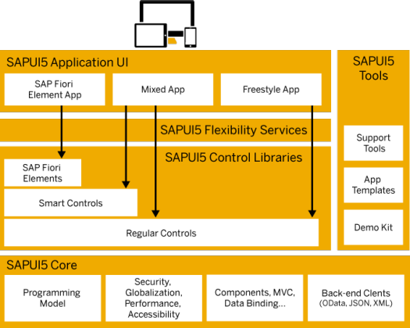
Under the Hood of SAP UI5
SAPUI5 simplifies web application development. A variety of UI controls, ranging from basic elements to complex UI patterns, can be combined for an appealing layout. All UI controls leverage a consistent design language and coherent UX patterns. SAPUI5 flexibility services let you easily adapt the UI of an app and store the changes in a layered repository.

Slide 21
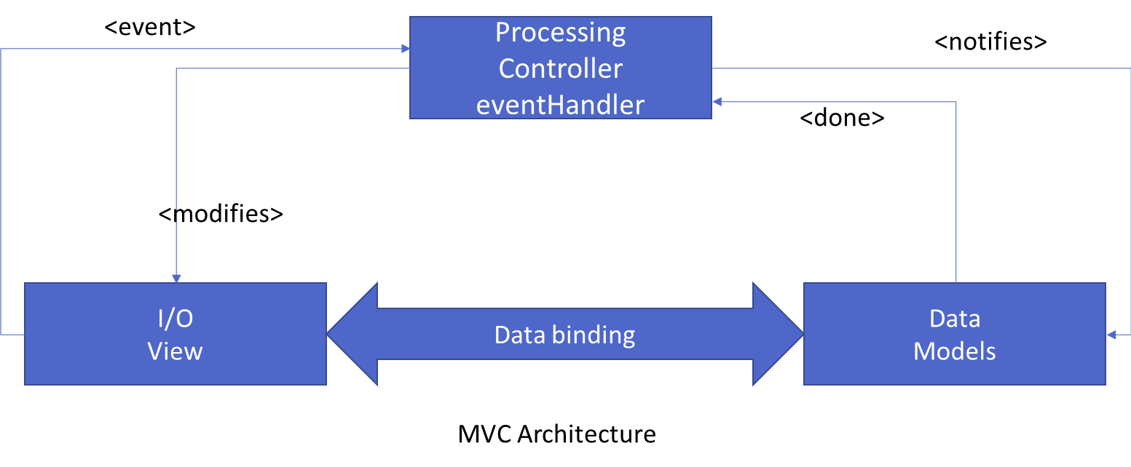
Introduction to MVC Architecture
MVC stands for Model, View, Controller.
Model:- The model component is a freely composed class that will keep the application data and do manipulations on it. All database accesses are done within the model.
View:- The View is responsible for defining the user interface to users. When a user sends a requests from his device, the view is responsible for data view as per the request submitted.
Controller:- The Controller is used to control the data and view events as per user interaction by updating the view and model.

Slide 22
Components of UI5 Application
The UI5 framework is built on top of open standards like HTML5, CSS, JS, and jQuery. We use MVC architecture to create applications using SAPUI5.
BAS
App
Developer
SAPUI5 Runtime Component
HTML+CSS+JS
sap.m
sap.ui.comp
sap.ui.table
sap.ui.layout
Renderer
sap.ui.core
sap.ui.unified
sap.ui.core.mvc
HTML5
CSS
JS
jQuery

Slide 23
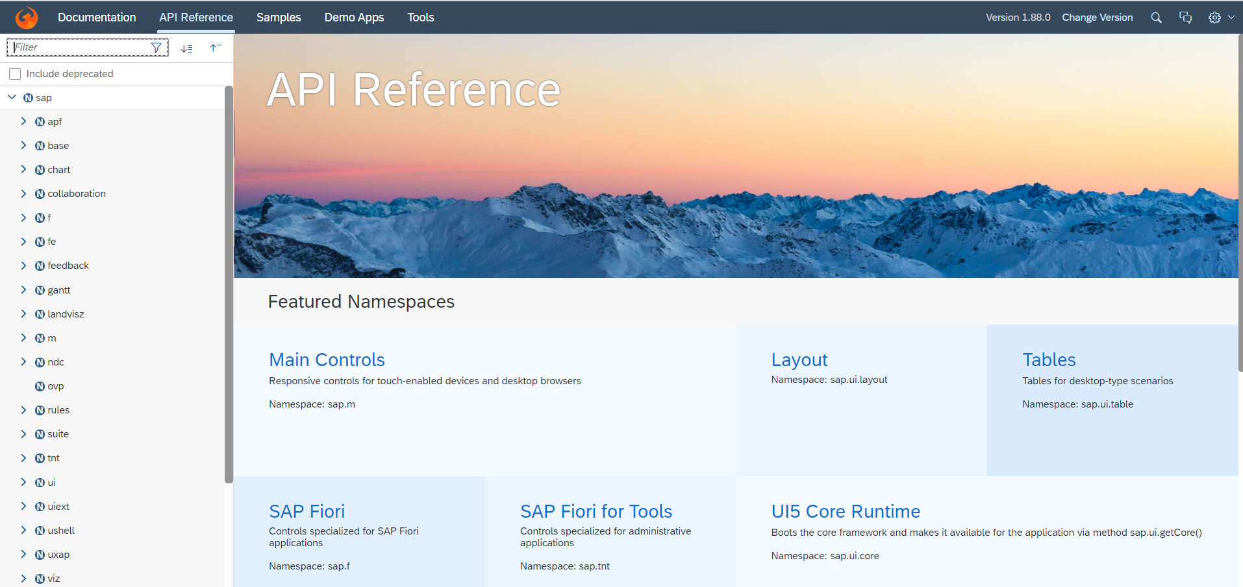
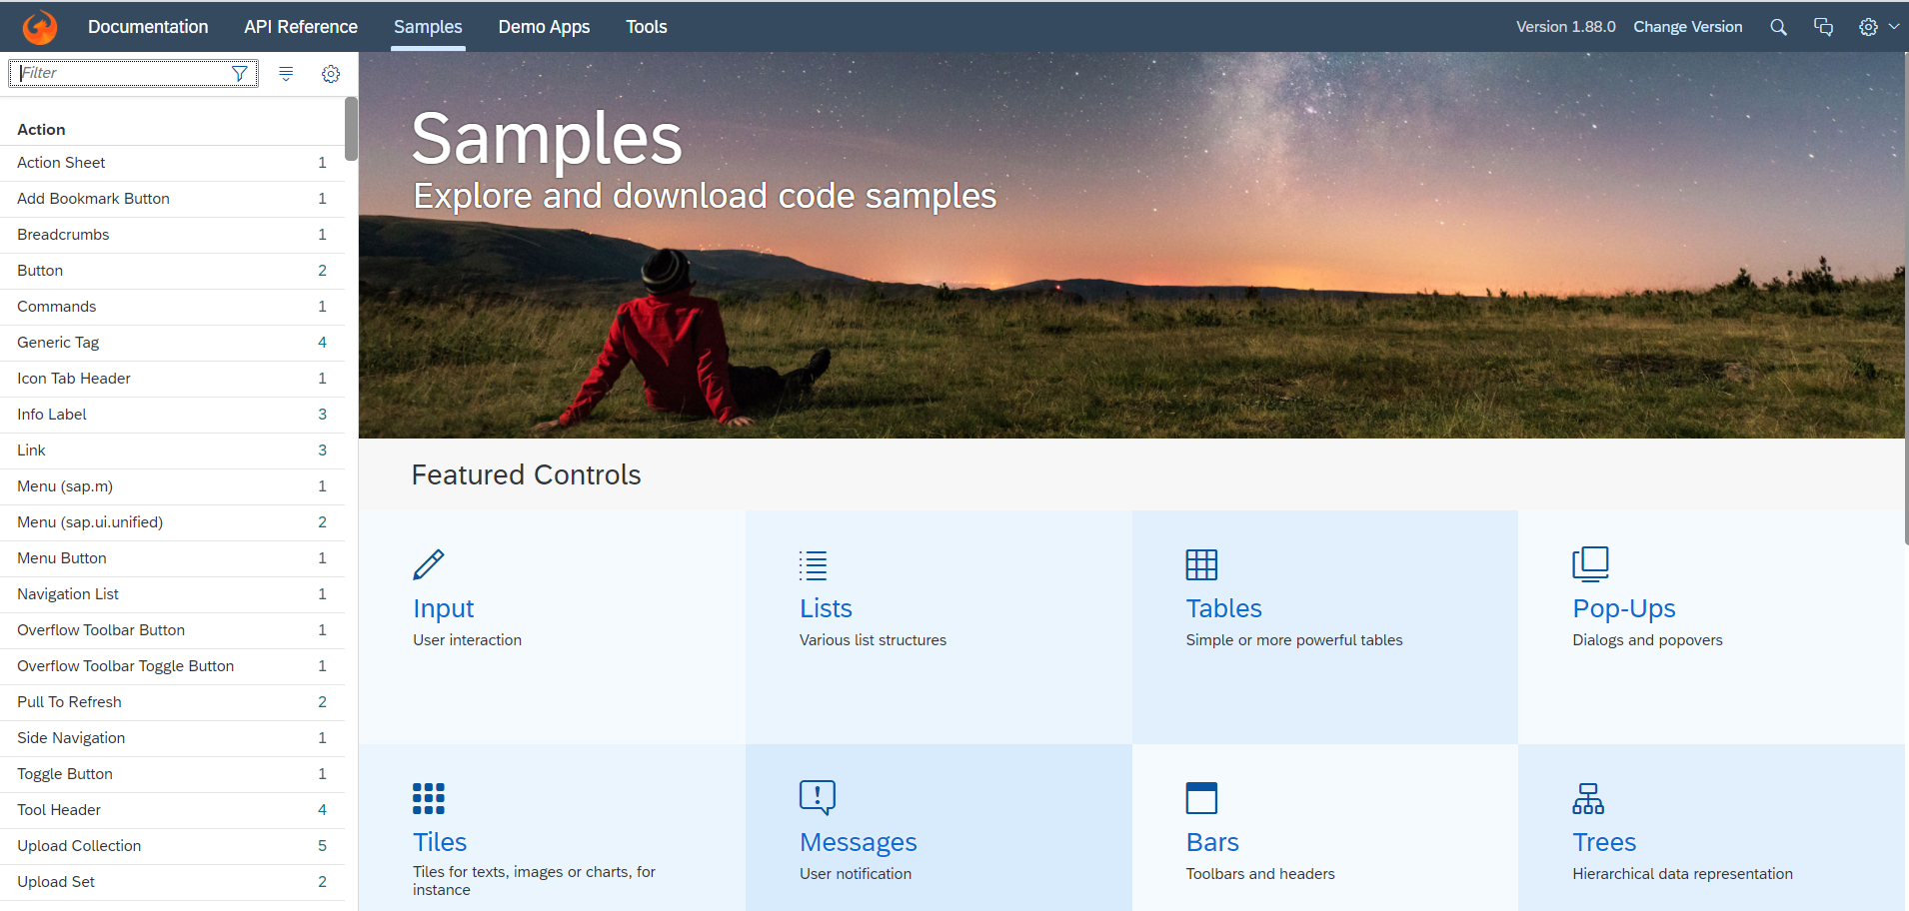
Introduction to UI5 SDK
Documentation of SAP UI5 is available at the SAPUI5 Software Development Kit.
We can access the SAP UI5 API’s at the Documentation page of SAP UI5 or you can use the link to go to sap’s API screen - LINK
We can directly search the required api’s on the SDK.
SDK contains the sample of all the controls which we can use in UI5
SAP UI5 API reference screen
SAP UI5 Sample reference screen

Slide 24
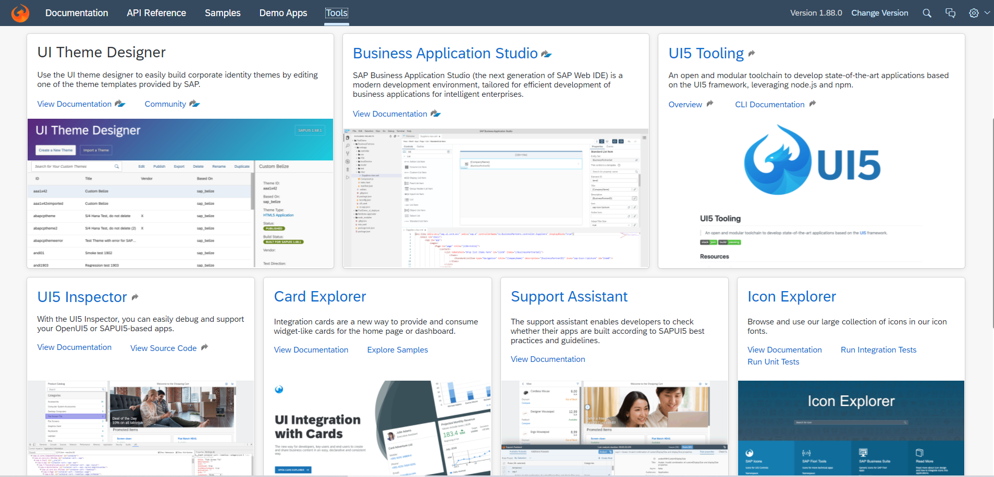
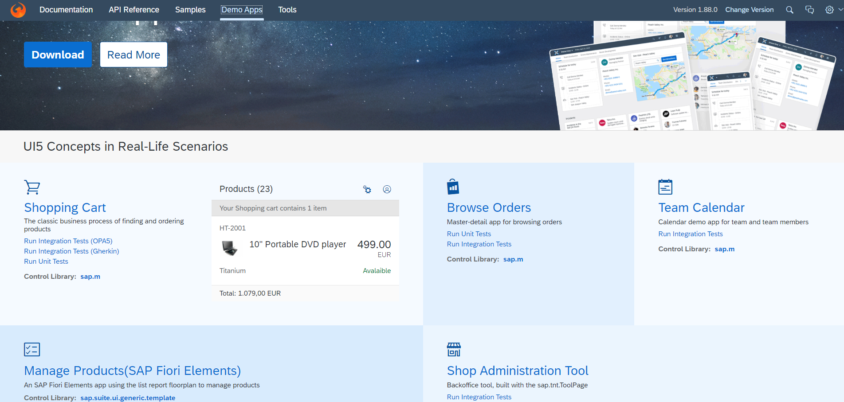
UI5 SDK continues…
UI5 SDK contains tools to make the development smooth for the developers.
It has UI5 icon packs which can be directly accessed for the UI5 SDK’s Tool Screen (Link).
SAP UI5 SDK provides us the demo application, So we can get an idea about how to create different type of applications using UI5 controls
UI5 SDK Tools Screen
UI5 SDK Demo Apps Screen

Slide 25
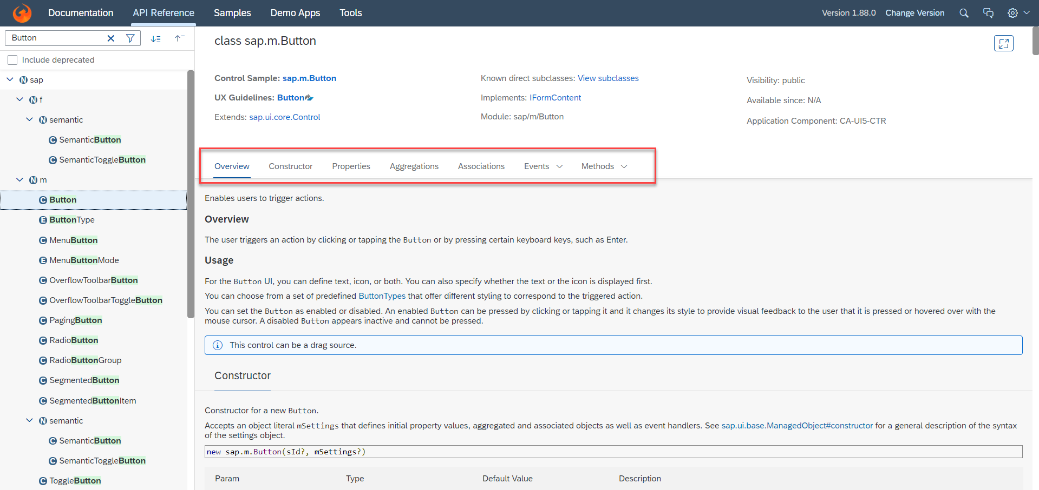
UI5 SDK continues…
When we search and open any API we see a screen similar to one which is shown below.
Every API contains different kind of:
Properties,
Aggregations,
Associations,
Events,
Methods

Slide 26
Creating first UI5 Application
Now we will create our first UI5 application.
In this application we are going to add a simple button provided in SAP UI5.
When the button is pressed it shows an alert popup at the top.
Steps to Create a UI5 app
Start with a project folder and all the productive files inside the webapp folder
Initialize a node project using (npm init)
Add a manifest.json file inside UI5 project (inside webapp) which talks about our project properties (sap.app, sap.ui, sap.ui5)
Mention that this is a UI5 type project hence we run a command called ui5 init
Create an HTML file index.html inside webapp folder.
Create HTML Head and body
Add the Bootstrap code for HTML, load sap ui5 from CDN https://sapui5.hana.ondemand.com/resources/sap-ui-core.js
Along with step 2, we will specify theme, library, and the path where all our project resources are present
Create object of our first view
Place this view in the body
Now create a view/Our view and in this view, we will add the control (JS View), when we implement view, we need to add 2 methods createContent and getControllerName
Create a controller (like a class) for this view, we can also put a constructor method onInit
Execute project using ui5 serve command

Slide 27

Exercise
Now we will create our first ui5 application by following the steps mentioned in the previous slide.
Exercise code/Resource:
index.html
Main.controller.js
Main.view.js
Mainfest.json

Slide 28

End of Day 3

Slide 29

Questions

Slide 30

Anubhav Oberoy

Slide 31


We’re committed to empower you to be
Most Desirable Resource
through powerful training solutions.
We build the workforce of the future.
250+
Corporate Clients
30,000+
Learners Trained
25000+
Learners Placed
FREE WEBINARS
Sign up for free webinars with industry experts every fortnight!
Enroll Now!
Contact us today!
https://anubhavtrainings.com/

Slide 32




More from AnubhavTrainings.com

Slide 33
Title
Content

Slide 34
Views in SAP UI5
View is responsible to manage information display to the users.
Views are based on Model.
There are Four types of views in SAP UI5, these are listed below:
XML View:- It is in the XML format. The file name ends with the extension “.view.xml”. There are no predefined methods in the XML view.
JS View:- It is in JavaScript format. The extension of the view file is “.view.js”.
JSON View:- It is in JSON format. The file name ends with the extension “.view.json”.
HTML View:- It is in HTML format. The file name ends with the extension “.view.html”. Here we create the controls within the <div> tags, as we do while developing HTML pages.
Percentage Usage of Views:
2%
99%
JOSN View – 0%
HTML view – 0%
JS View is used only in 2% of the views.
XML Views are the mostly used views now a days.
The use of JSON and HTML views are negligible

